Slide 1

Normalization & Tables
Group#14
Neelam Shehzadi(110852)
Shanzay Mahmood(110828
Submitted to :
Prof. Sherish Khan

Slide 2
Queries used For making tables
CREATE DATABASE database_name;
USE database_name;
CREATE TABLE table_name ( column_name1 DATA_TYPE, column_name2 DATA_TYPE,…...);
INSERT INTO table_name (column_name1, column_name2, ...)VALUES (value1, value2,…...);
SHOW DATABASES;
SHOW TABLES;
DESCRIBE table_name;
UPDATE table_name SET column_name = new_valueWHERE condition;

Slide 3
Queries used For making tables
ALTER TABLE table_name ADD COLUMN column_name DATA_TYPE;
ALTER TABLE table_name MODIFY COLUMN column_name NEW_DATA_TYPE;
ALTER TABLE table name DROP COLUMN column_name;
DELETE FROM table_name WHERE condition;
DROP TABLE table_name;
DROP DATABASE database_name;
SELECT * FROM table_name;
SELECT column_name1, column_name2 FROM table_name;
SELECT * FROM table_nameWHERE condition;
SELECT column_name AS alias_name FROM table_name;

Slide 4

Entity relationship diagram

Slide 5
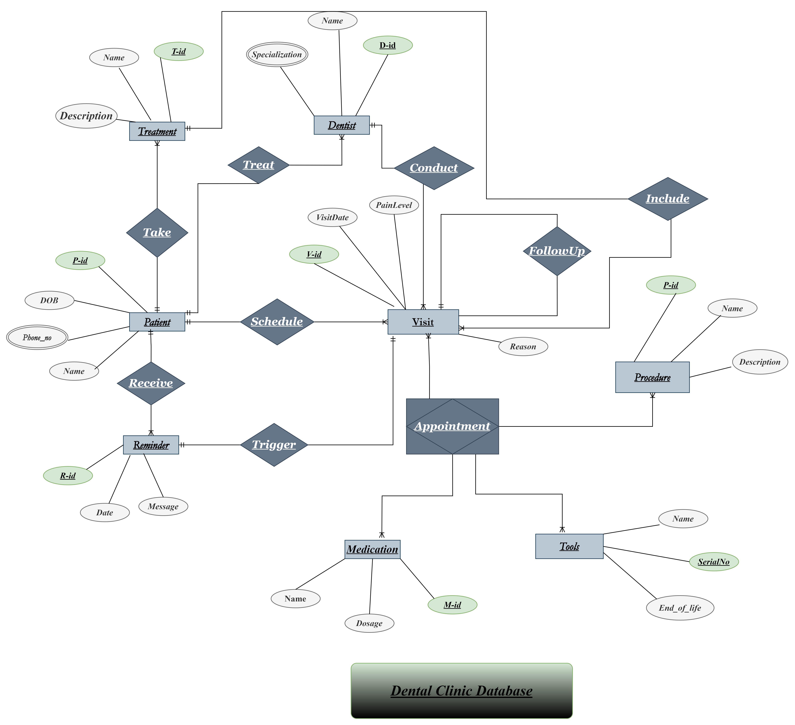

Slide 6
Normalization
Normalization

Slide 7
The database schema was carefully reviewed and found to already following the principles of normalization up to the Third Normal Form (3NF).
Each table contains atomic values, ensuring that all attributes store indivisible data.
No partial dependencies exist, as all non-key attributes are fully functionally dependent on the primary key.
Moreover, there are no transitive dependencies between non-key attributes.
As a result, the database design eliminates data redundancy and ensures data integrity.
The relationships between tables, such as one-to-many and many-to-one associations, have been established to maintain consistency and prevent anomalies during data operations.

Slide 8
MYSQL TABLES AND Entities:
The following entities and tables demonstrate normalization principles in a dental clinic database.
Patient: p_id, patient_name
Patient Phone: p_id, phone_no (multiple phones per patient)
Dentist: dentist_id, dentist_name
Dentist Specialization: dentist_id, specialization (multiple specializations)
DentalProcedure: pd_id, procedure_name, description
Medication: m_id, medication_name, dosage
Tool: serial_no (varchar), tool_name, end_of_life
Visit: v_id, visit_date, r_id (reminder reference)
Reminder: r_id, name, description
Appointment: ap_id, v_id, pd_id, m_id, serial_no
VisitProcedure: v_id, pd_id (link visit to procedure)
Multivalue Attributes Normalization:
Since relational databases do not support multivalue attributes directly, we create separate tables:
Patient Phone: Stores multiple phone numbers for each patient
Dentist Specialization: Stores multiple specializations per dentist

Slide 9
Slide title 29
TABLES

Slide 10




overview
Entities:
INSERT
With their attributes.
Command on MYSQL.
Entities
UPdate
Becomes tables while when you are dealing with the relation schema.
on MySql.
Tables
AS
Of each entites along with select command.
Alias on MySql.

Slide 11
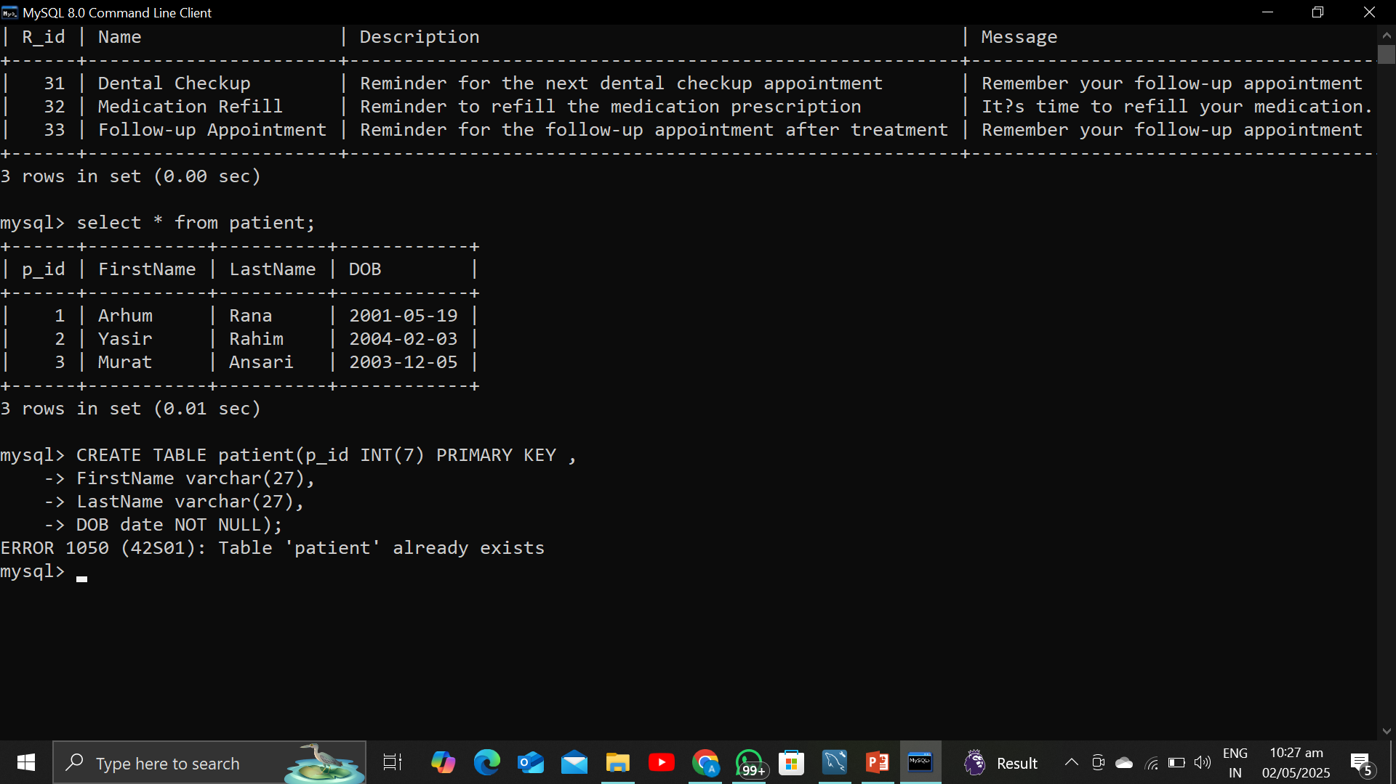
Patient Table:
Query on MYSQL:
Patient table containing values:

Slide 12
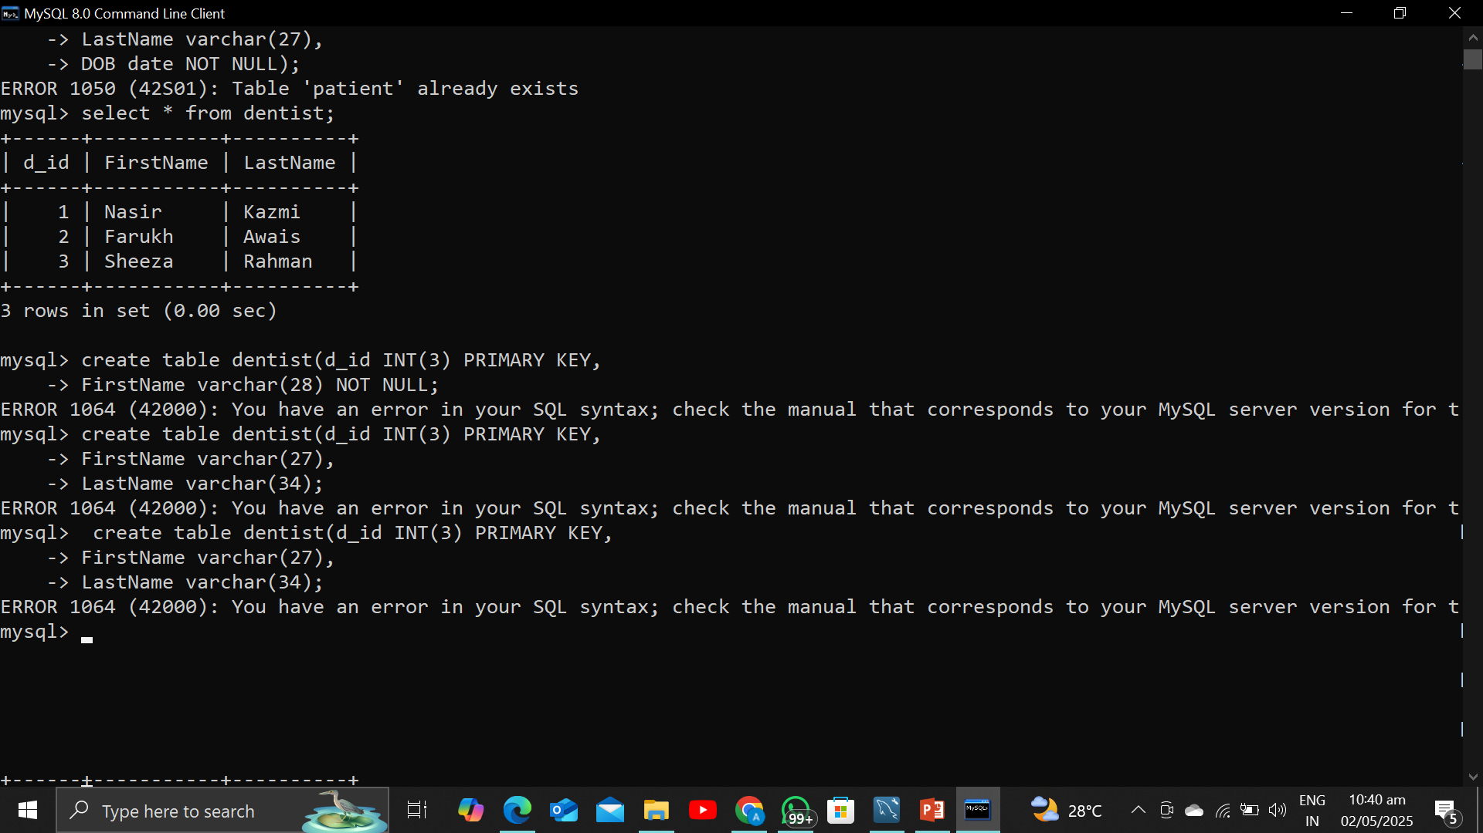
Dentist table:
Query to create table:
Dentist table along attributes:

Slide 13
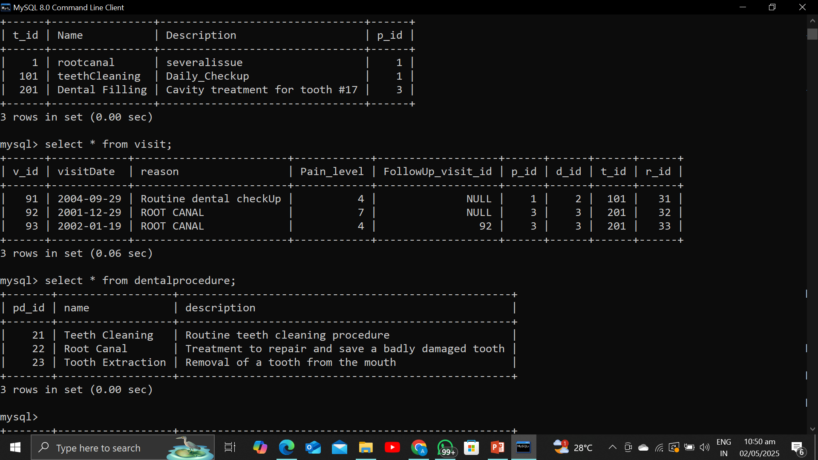
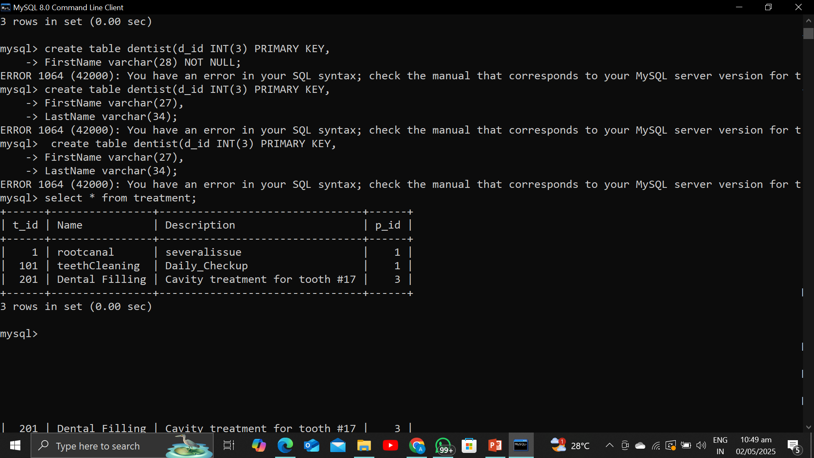
Treatment and Procedure tables:
Procedure table:
Treatment table along attributes:

Slide 14

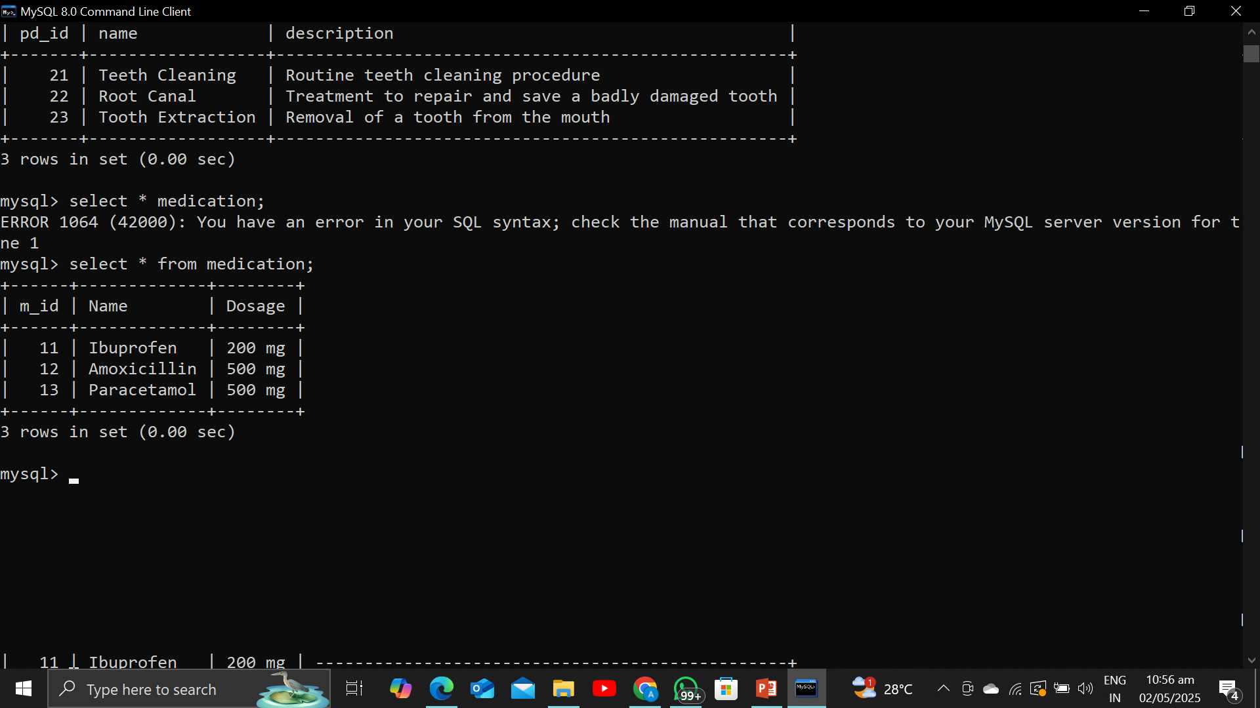
Visit and medication tables:
Visit table with attributes:
Medication:

Slide 15
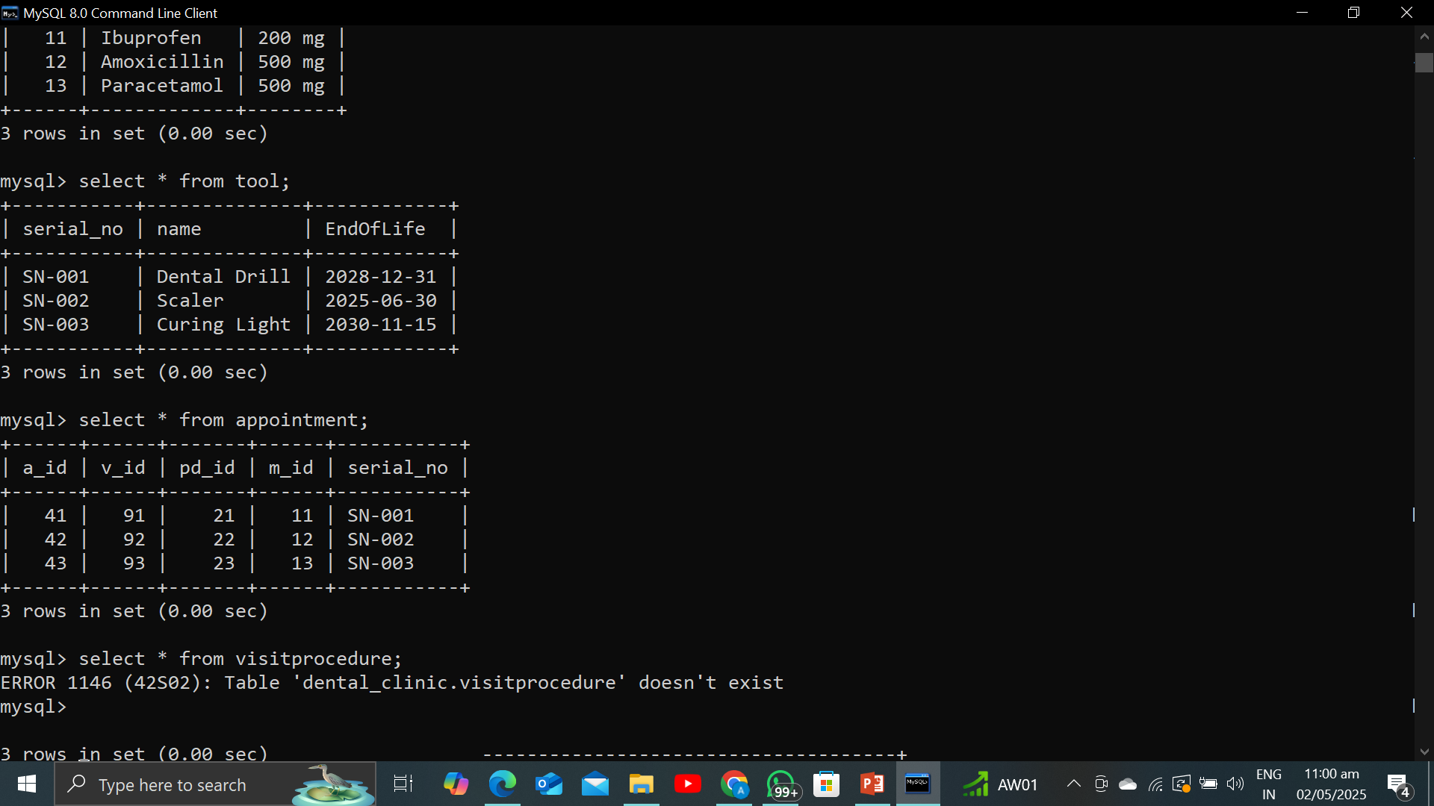
APPOintment and tool:
TOOl\Equipments:
Appointment(Associative):

Slide 16

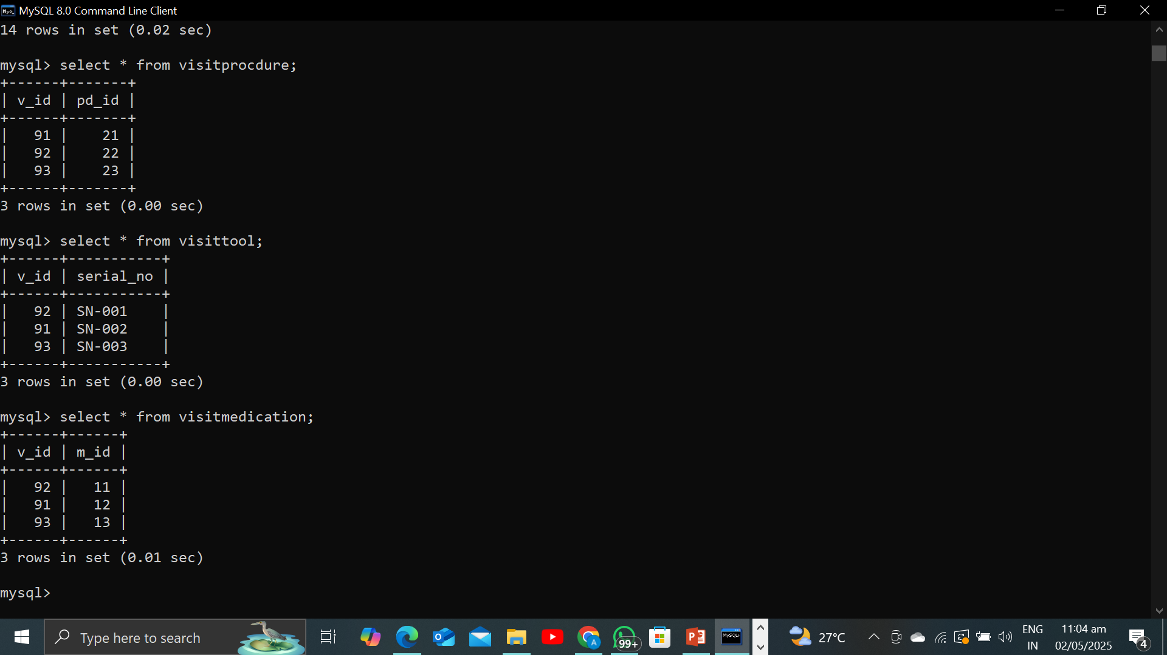
Junction tables for M:M relation:
VisitProcedure:
VisitMedication:
VisitTool:

Slide 17
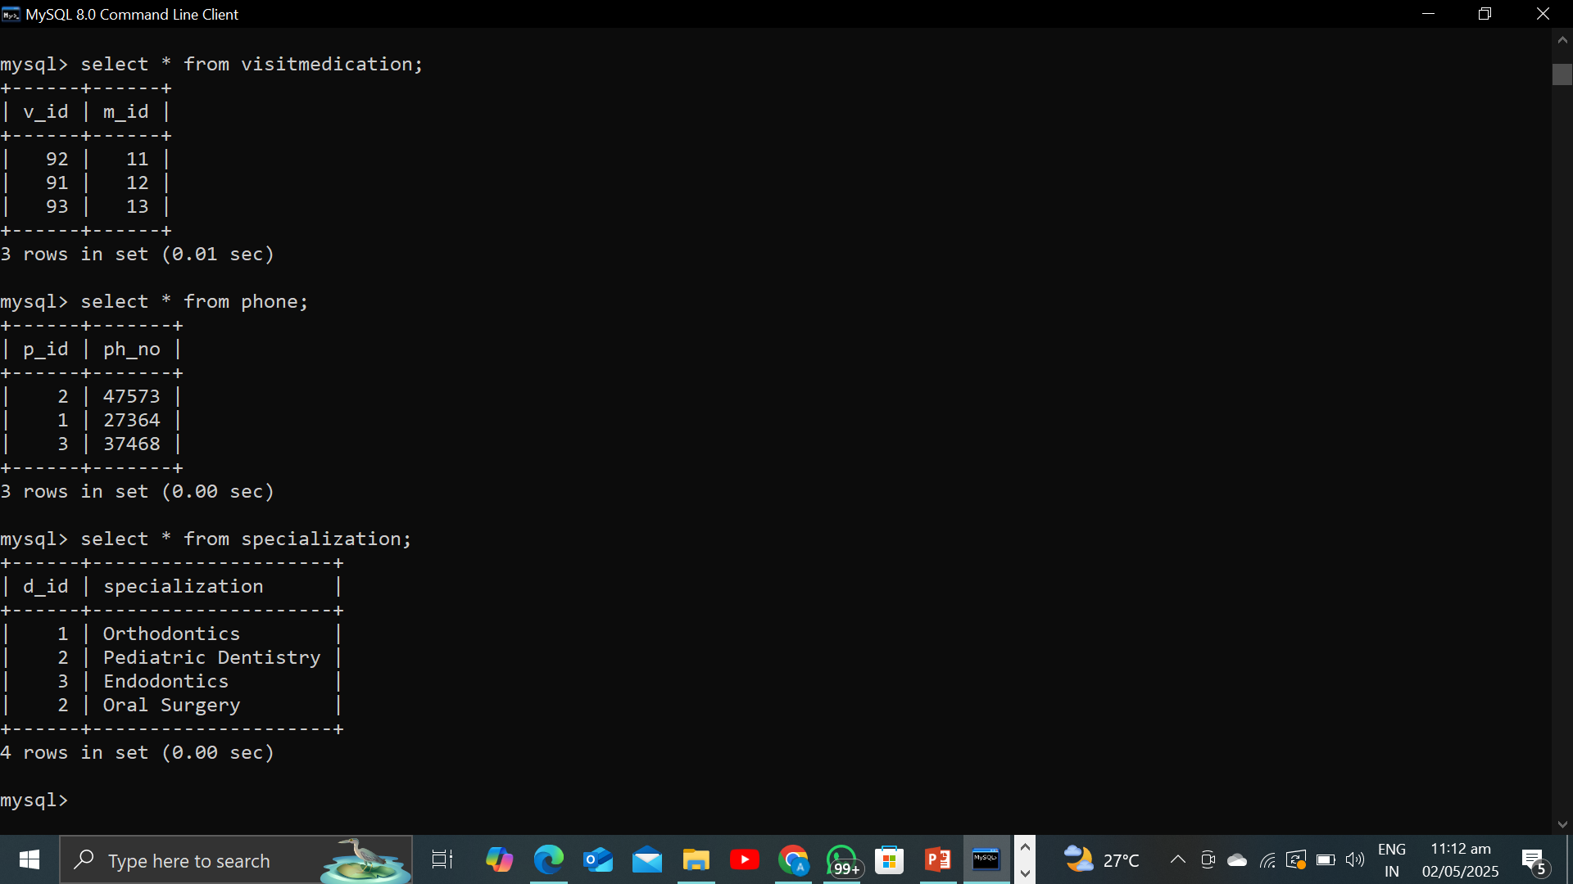
Multivalue attributes:
PHONEN_NO in Patient:
SPECAILIZATION in Dentist:

Slide 18
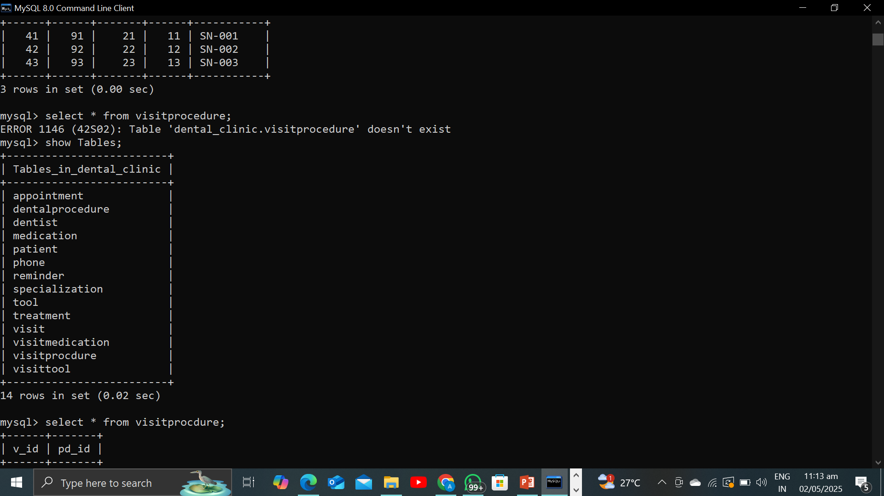
ALL the tables included in our db:
With the help of SHOW TABLES: You’ll ab able to see the all the tables which is present in your database.

Slide 19
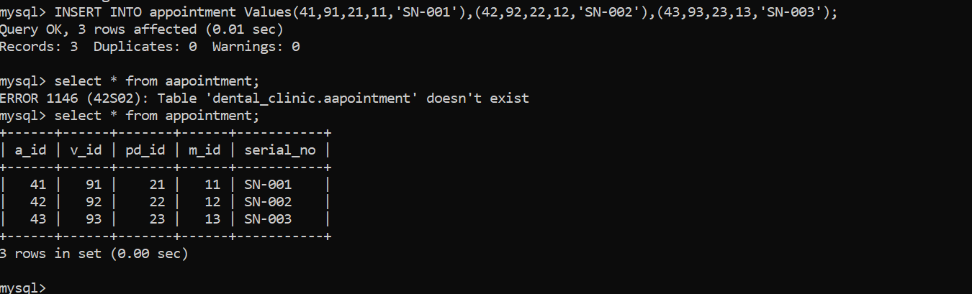

Insert command on mysql;
INSERT INTO table_name VALUES (………………..);

Slide 20
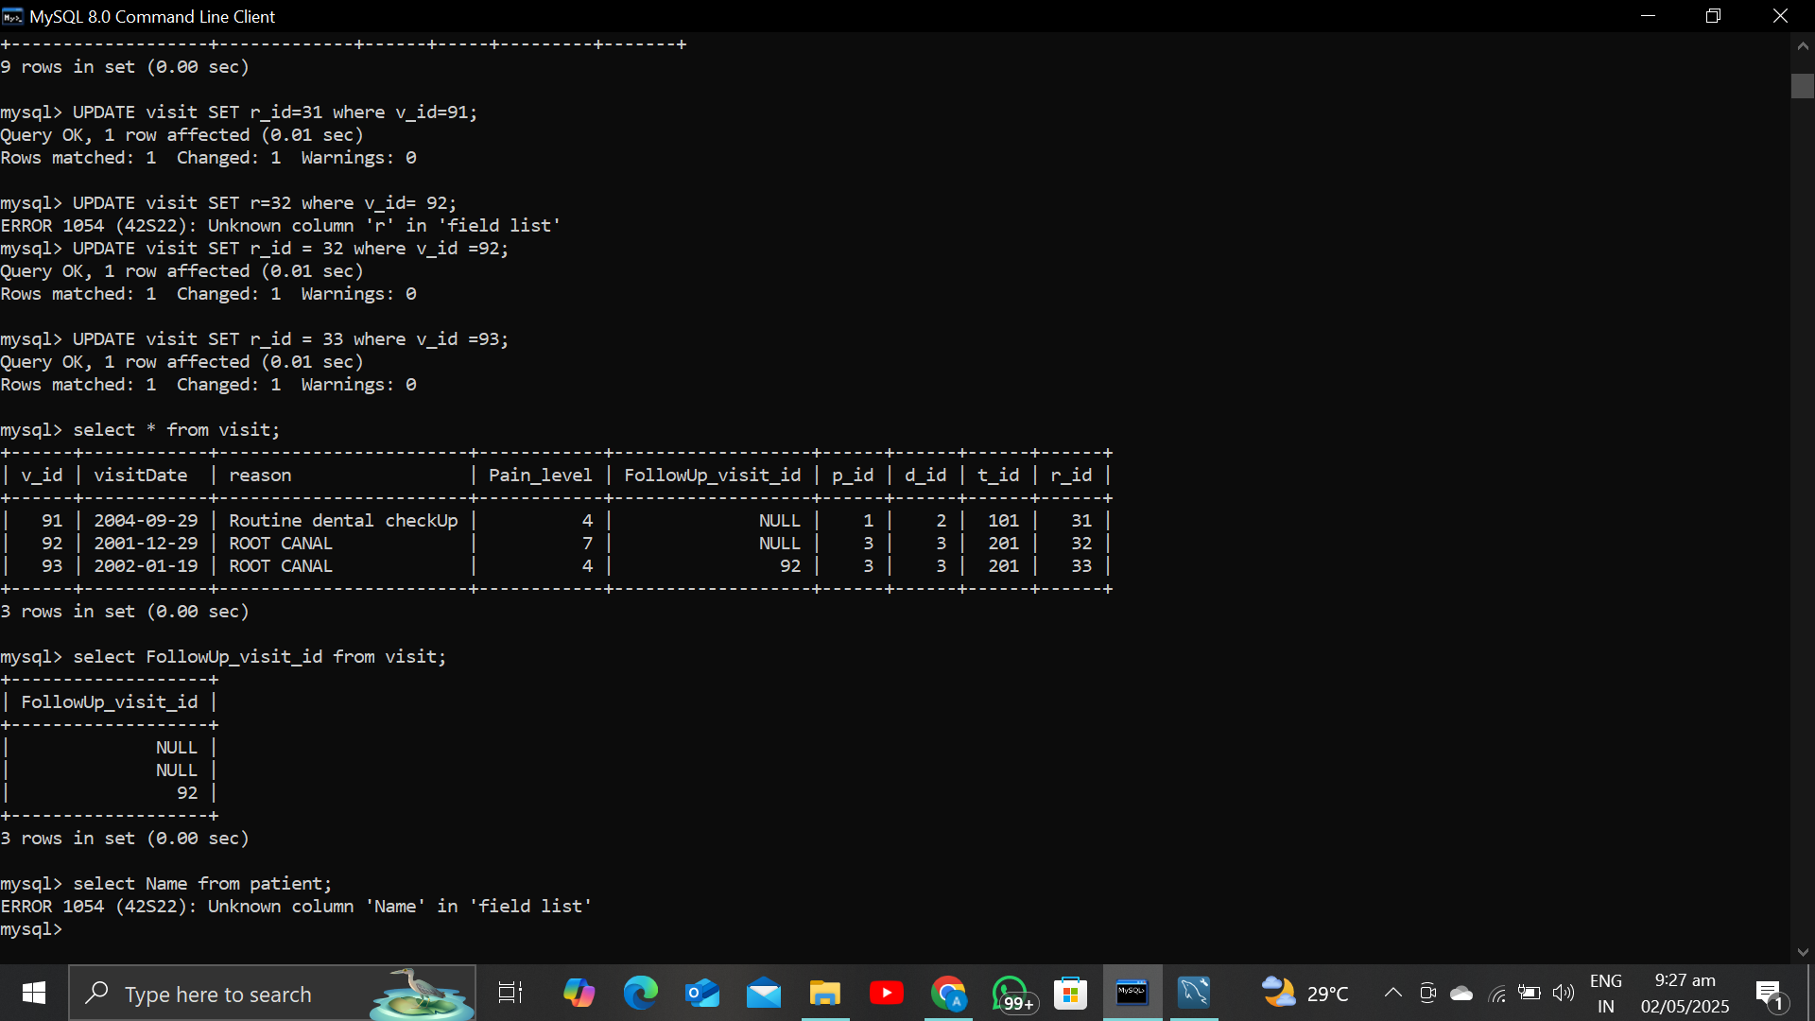
UPDATE Command:
UPDATE table_name SET column_name=“ “ where column=“ “:

Slide 21
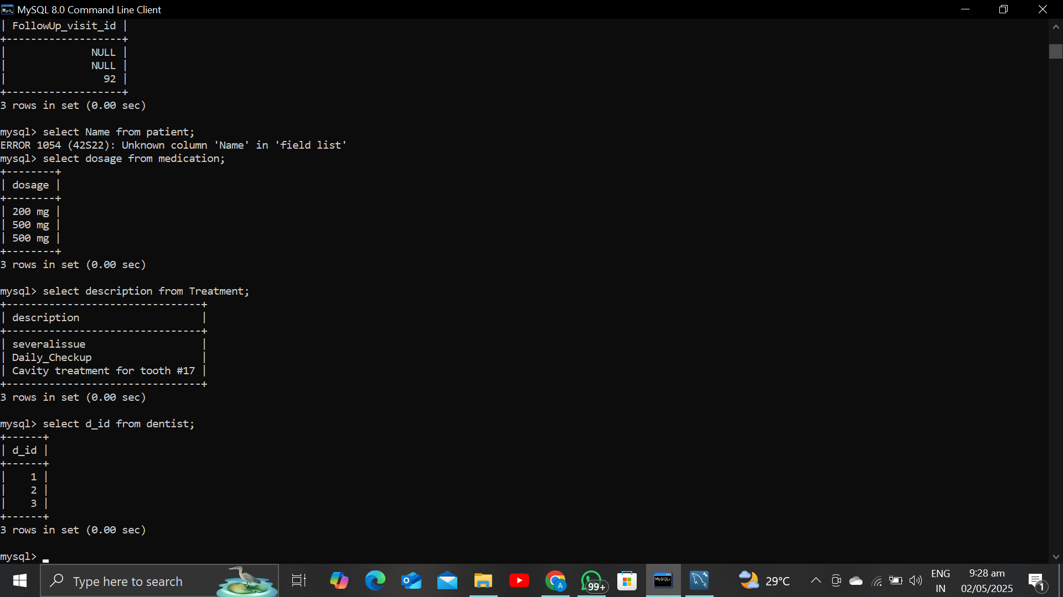
TO select a certain coumn from the table:
SELECT Column_name from table_name;

Slide 22
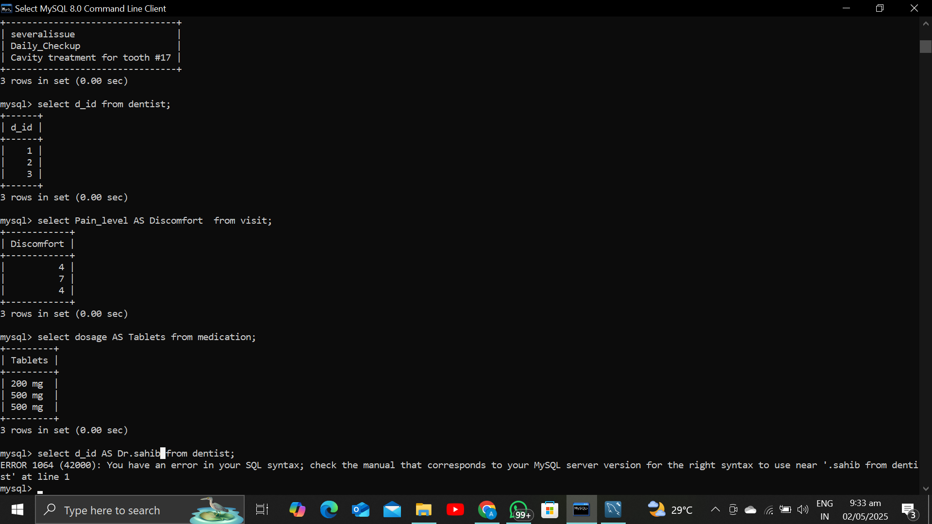
Select name by Alias :
SELECT original_name AS alias from table_name;

Slide 23
CONClusion:
In conclusion, the dental clinic database effectively applies normalization principles to create a structured and efficient system for managing patient and clinic information. By organizing data into distinct entities and ensuring that multivalue attributes are handled appropriately, the database minimizes redundancy and enhances data integrity. This thoughtful design not only streamlines operations but also improves the overall quality of patient care, making it easier for the clinic to deliver exceptional service. Ultimately, the database serves as a vital tool in supporting the clinic's mission to provide effective and organized dental care.

